Slide 1
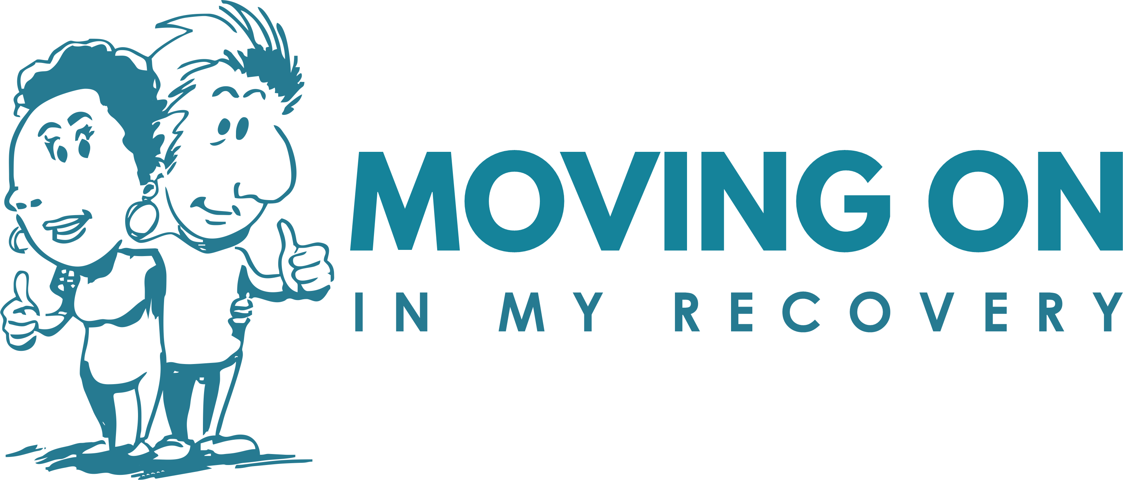
An Approach for Services
Brajna Greenhalgh
Helping Groups to Grow Developments

Slide 2
HG2GD & MOIMR Background
Since 2014, Helping Groups To Grow Development have helped hundreds of people across Wales achieve sustained recovery from addiction through highly impactful, acceptance – based, cognitive behavioural programmes: Moving On In My Recovery (MOIMR), Pathways To Recovery (P2R) and Nudge.
These life changing programmes, with growing evidence base, were developed by an NHS consultant clinical psychologist (Dr Lee Hogan) alongside hundreds of people with lived experience of addiction.
Since their development, these programmes have been rolled out to third sector providers across Wales and credited with helping hundreds of people achieve a sustained recovery from addiction.
The benefits of HG2GD programmes have been wide reaching, profoundly empowering - providing individuals with drug and alcohol problems with the skills and strategies to live more fulfilling lives and in turn to support others seeking recovery.

Slide 3
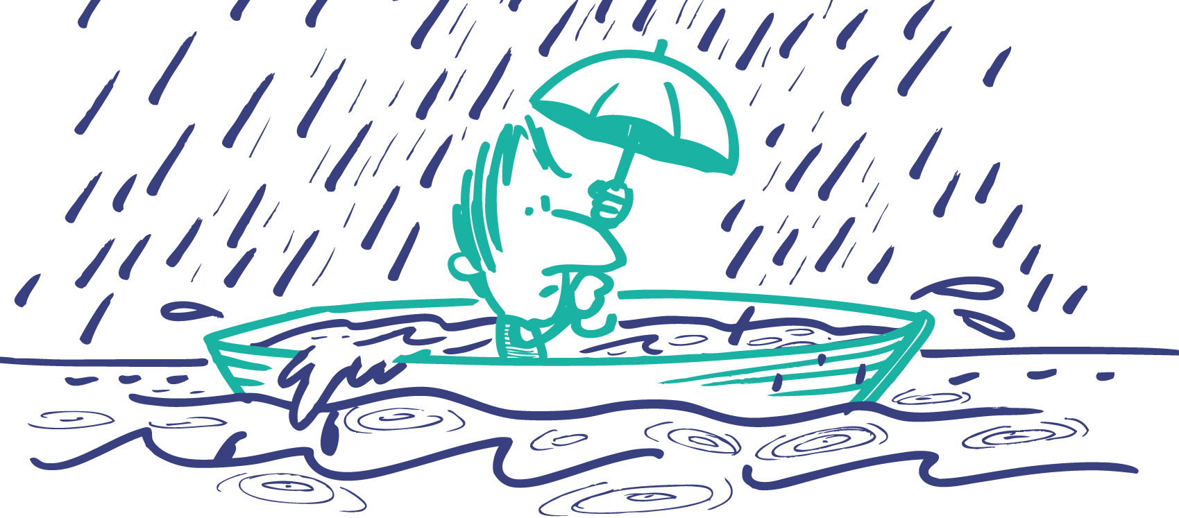
Working to promote recovery & to enhance outcomes
What is that leads to a person to keep using alcohol or drugs despite encountering numerous negative even catastrophic consequences? (Illogical, Irrational, Self-defeating)
Wanting to stop and not wanting to stop at the same time (solve the problem but not have the consequences = ambivalence)
Ambivalence is the key issue to resolve for change to occur (ambivalence is NOT pathological)
However, as ambivalence in our interactions can feel unpleasant, we often make the error of pushing people to commit to change before they are ready to do so.
Therapeutic Stance – equity, being vulnerable, compassionate, genuine; does not lecture or coerce; models acceptance of challenging content; undermines experiential control; helps to clarify valued directions; distinguishes between values and goals.
(Building patterns of committed action – plans actions in line with values; finds sources of value in small steps)

Slide 4
The Struggle of Addictive Behaviours
In living life we all encounter pain:
often it is not even our fault
What is it you are escaping from – your own vulnerability?
It undermines other aspects of life: our health, relationships, finances etc
e.g., we drink, drug, avoid, get angry, obsess, eat, isolate etc
Like, guilt, shame, regret, & fear
These things block out the pain but they get in the way of living a fulfilled life
We experience dissatisfaction, loss / suffering
As a species we are hardwired to escape pain
We learn to do what works effectively in the short-term
This creates more pain in the long-term
It leads to self -criticism and also reinforces the idea that…
Somehow, we can feel as if we are to blame, or are damaged, bad, broken etc
Also note that some behaviours like alcohol and drug use have many rewarding properties – relaxation, social camaraderie, buzz etc
Copyright© Dr Lee Hogan

Slide 5
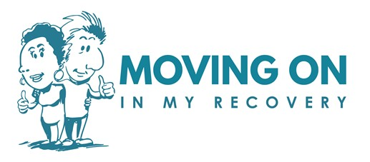
MOIMR: Vulnerability Model
Connect to the here and now
Accept that change is a necessity
Connect to peers who have taken this path
With curiosity
Develop willingness and acceptance
Open up to dissatisfaction, Loss / Suffering
Acknowledge the need to learn a different way
Feel safe enough to do it
Make space for the experience
Open up to vulnerability
Lean in to it
Recognise that escape has been ineffective in the long-term
In vulnerability is connection, safety, love
Do the things that matter
Let go of the unhelpful content
Draw on your courage
Find what it is you value and
move towards it
Unhook from difficult thoughts or feelings
The more practised we become at opening up to our vulnerability (as we move towards the things that matter to us) then the more connected, satisfying and fulfilling life can be
Note: whenever something truly matters to us then it increases our feelings of vulnerability
Copyright© Dr Lee Hogan

Slide 6
Our Programmes
Nudge (MI & ACT consistent)
Often person is chaotic and using
There is a downside and an upside!
Pathways to Recovery (ACT)
Often the person wants change but is entrenched
MOIMR (ACT)
Often in the very early stages of recovery
Staying in recovery is difficult

Slide 7
NUDGE
“Sometimes the smallest step in the right direction ends up being the biggest step of your life. Tip toe if you must but take that step.”
^{- Anonymous}
Copyright © Helping Groups to Grow Development
Illustrations © by Roger Mason 2018

Slide 8
How does Nudge work?
Nudge: a four session programme based on MI and ACT; designed for those who are typically in pre-completive/contemplative stage, with the main aim to motivate participants to engage.
Nudge examines the struggle of opposing/competing positions people experience and it helps to encourage acceptance of these positions. Previous, simple solutions are seen as invalidating and yet simple solutions are necessary! People feel hopeless and yet hope is needed
It validates and normalises feelings of ‘stuck-ness’ & ambivalence – there is a function to behaviours that are also self-defeating
It builds on the discrepancy between where a person is and where they want to be.

Slide 9
Nudge: Mechanism of Change
Making change more probable
Understanding context
Help to establish the function of use
Establishing a non-blaming perspective
Contemplate doing something different
Finding sources of reinforcement
Develop basic (simple skills) for action
Moving forwards and the next steps

Slide 10
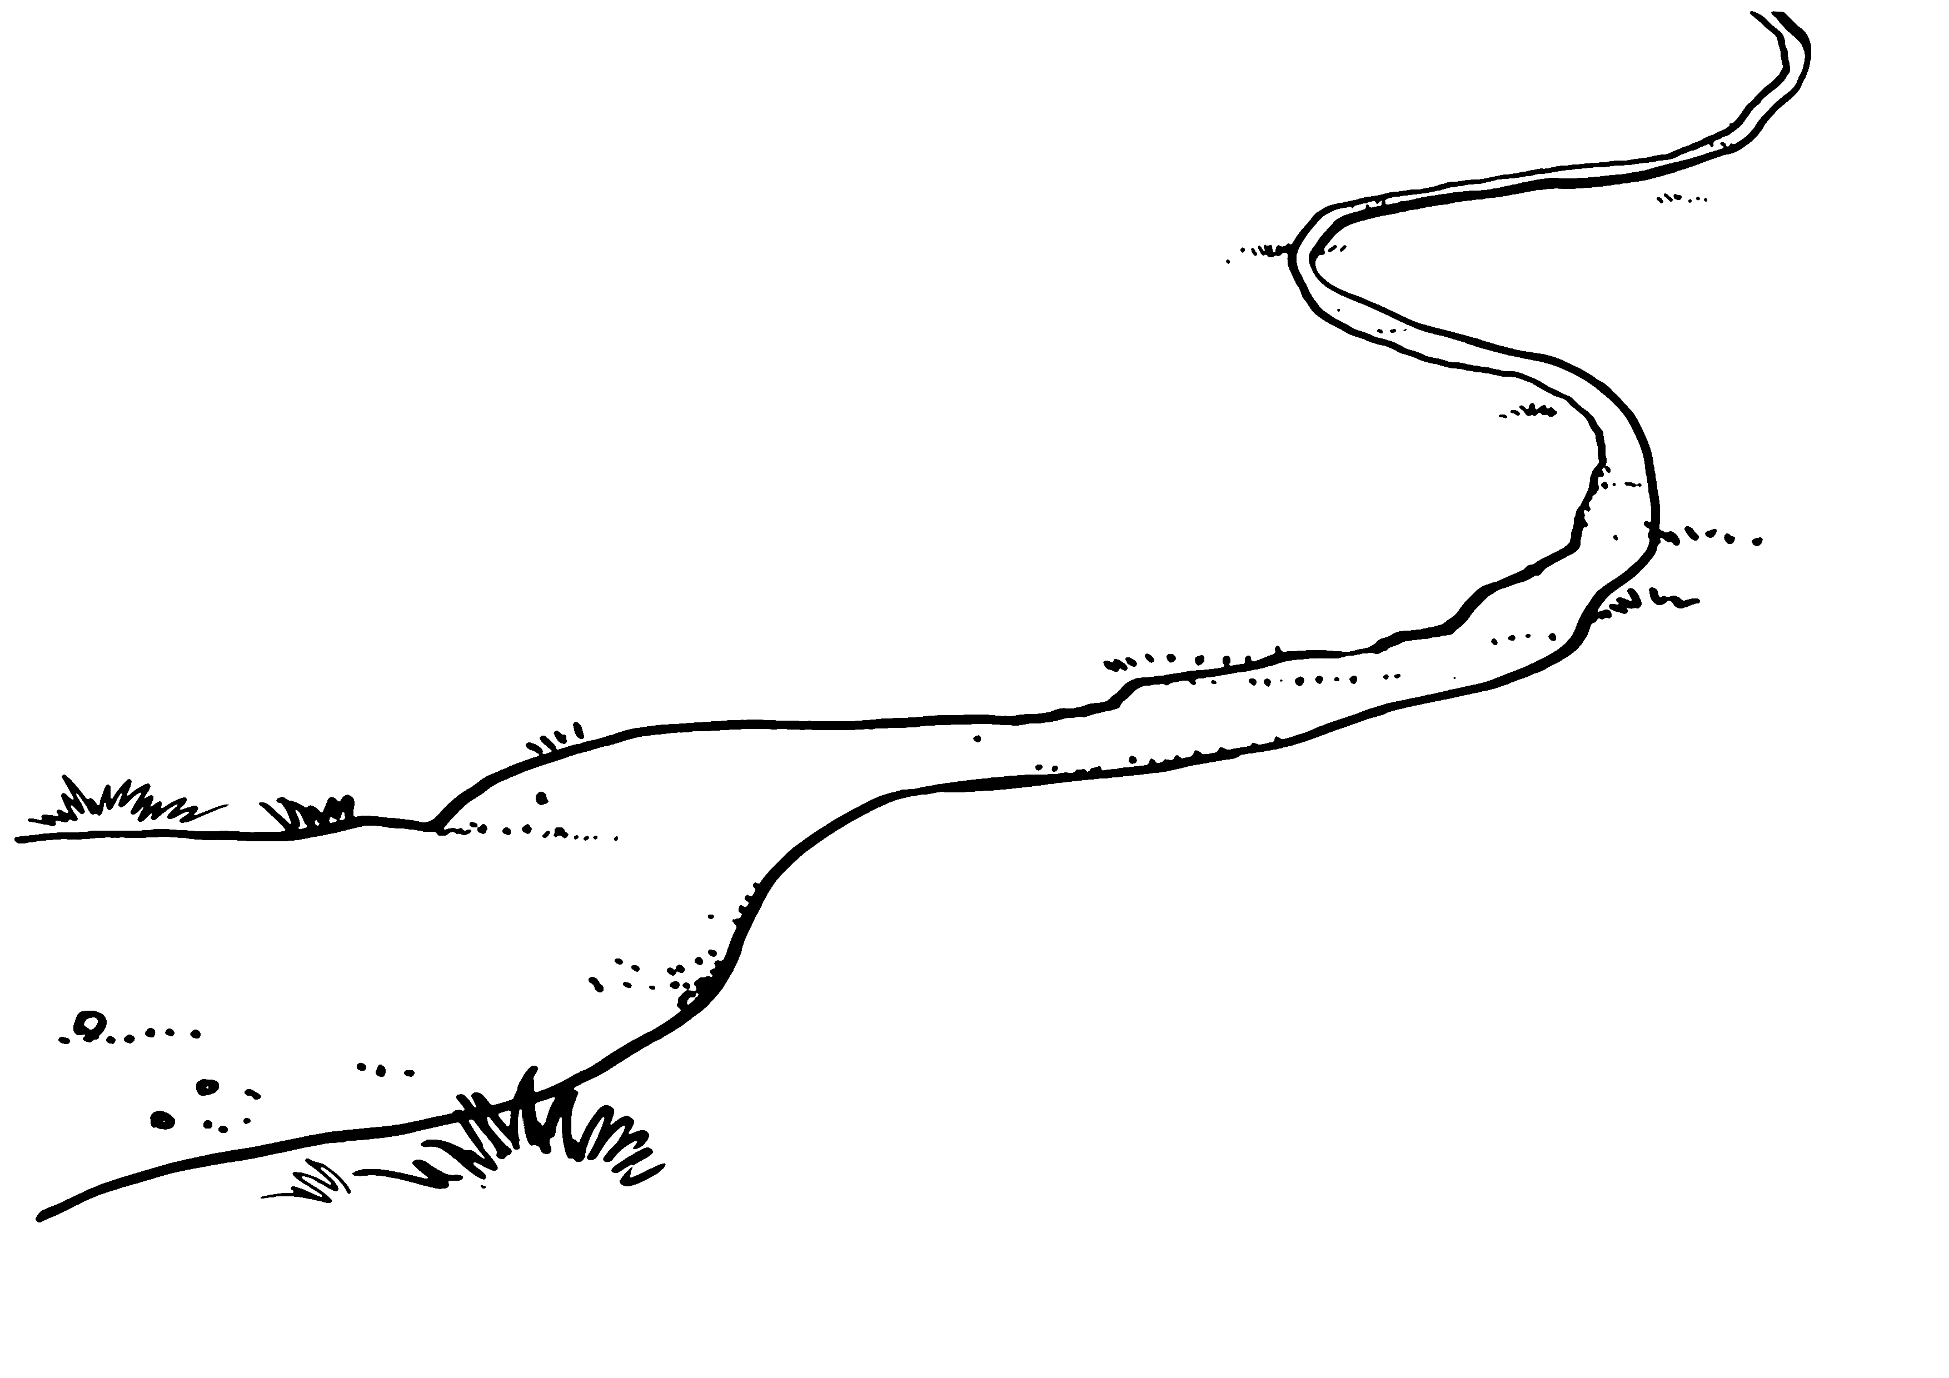
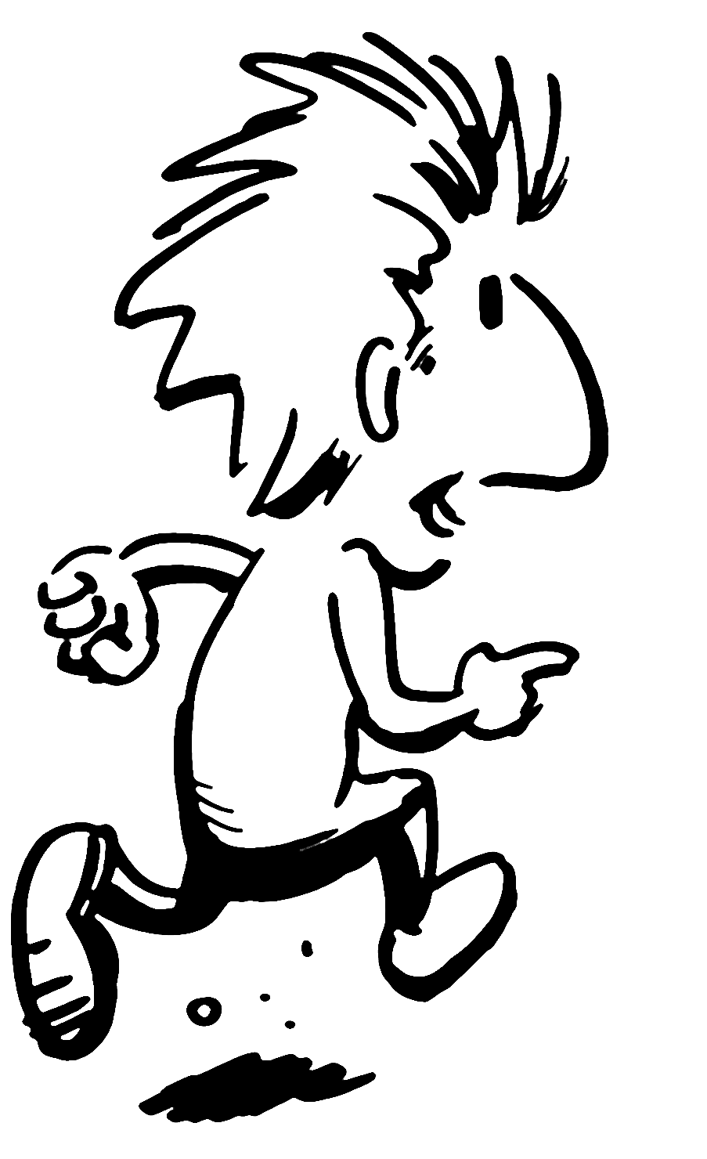
PATHWAYS TO RECOVERY
“Sometimes the smallest step in the right direction ends up being the biggest step of your life. Tip toe if you must but take that step.”
^{- Anonymous}
Copyright © Helping Groups to Grow Development
Illustrations © by Roger Mason 2017

Slide 11
How does P2R work?
Pathways to Recovery (P2R): a twelve session programme based on ACT and aimed at those who wish to change but struggle to achieve it.
Connecting to values and gaining some momentum with the weekly challenge
We are attempting to create psychological flexibility: “Leaning In” & “Letting Go”;
Defusion from thoughts and feelings: letting go
Developing curiosity to experiences: leaning in
A shared journey
Each session has a “check in”, which fosters engagement and a sense of a shared journey; it also an opportunity to practice skills like leaning in to vulnerability;
Each session has a weekly challenge, which encourages commitment and action towards values.

Slide 12
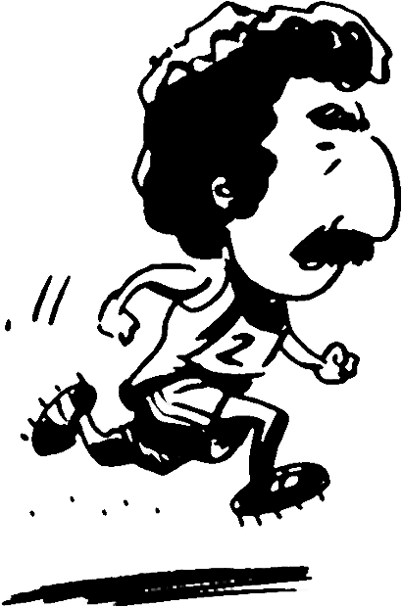
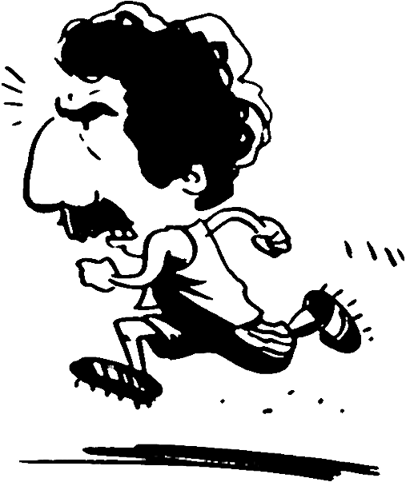
REFUSING LIFE AS IT IS…
When we spend our time so focused on moving away from thoughts it has a negative consequence on the other areas of our life. We get in the habit of moving away.
So when we do pluck up the courage to begin moving toward what matters to us we hit up against fears or distress…
We see what we have to lose…and then we move away…
Notes:
The idea here is that the person runs into a block and changes direction. The running man is fine but the block (wall) might be better represented. Note animations work well.

Slide 13
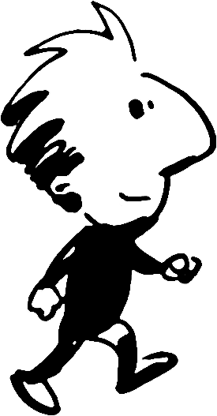
MOVING ON
IN MY RECOVERY
“Sometimes the smallest step in the right direction ends up being the biggest step of your life. Tip toe if you must but take that step.”
^{- Anonymous}
Copyright © Helping Groups to Grow Development
Illustrations © by Roger Mason 2015

Slide 14
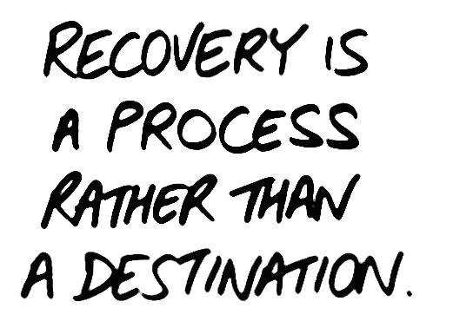
Moving On In My Recovery
Moving On In My Recovery (MOIMR): a 12 session group programme (but can also be delivered one-to-one) based on ACT; aimed at those who have recently achieved abstinence and to support their ongoing recovery.
Draws on the experiences of people who are in recovery themselves
It has similar aims to P2R: an attempt to create psychological flexibility – “Leaning In”, “Letting Go”, Perspective Taking
Each session has a “check in” and a weekly challenge

Slide 15
Mechanisms of Change
MOIMR is often not what participants anticipate
It is not re-living the past but it can be reflecting on experience
It is not being told what to do but it is hearing about others have managed change
It is creating a safe space to open up to vulnerability
Peers at various stages of recovery are so important
They show participants what to expect (i.e., change is not instant, you have to commit, although the small stuff feels irrelevant it’s not, CHANGE IS POSSIBLE!)

Slide 16
Sessions 1 to 6
Identifying value-led goals (using fear as a motivating force)
Developing anchor points and gaining lifestyle balance
Protecting wellbeing and learning to let go
Taking the step to lean in to anxiety
Managing mood and getting flexible with thinking
Working with relapse – observing and letting go

Slide 17
Sessions 7 to 12
Using peer support and understanding the importance of perspective taking
Working with relationships and accepting change
Accepting the self – letting go and connecting to values
Developing ways to accept the pain of loss
Working with self-stigma by increasing willingness and self-compassion
Recognising vulnerability on the next steps to recovery

Slide 18
A MOIMR Excerpt – Vulnerability
You can toss one but not without getting rid of the other.
If I say I CANNOT have this thought / fear,
then I cannot have this…
Often when we contemplate a new hope – getting a new job, starting a new relationship, or taking on a new project then fear can show up – what if I am not good enough? What if I fail?
Two sides of the Same Coin
Notes:
A short example of moving towards vulnerability

Slide 19
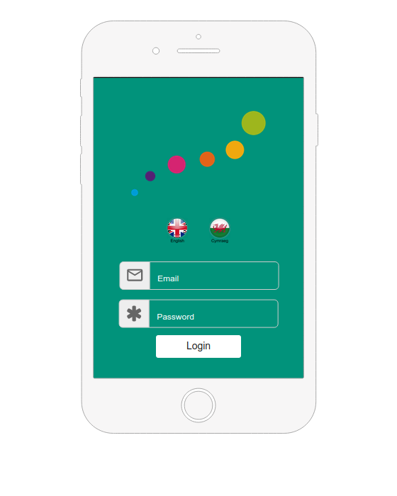
Moving On App
Notes:
Anticipated completion of the App is May 2021

Slide 20
Our Criteria for Content
We want the App to target:
Engagement – with the App and recovery
Connectedness – to others in recovery
Commitment – to change and recovery

Slide 21
App Design
My Recovery/Wellbeing
My Check In
My Sessions
My Tool Box
My Challenges
Emergency Contacts
Inspirational Quotes

Slide 22
The Moving On App
We see that the App can enhance MOIMR in several ways…
Access to learning – session summaries, reflective exercises
Improving motivation and commitment – challenges are recorded, prompts given, success evidenced
Outcomes and progress can be easily accessed
Real-time interventions are available
Quick links to crisis numbers are also available

Slide 23
Summary
We have a range of psychosocial group-based interventions in the Substance Misuse Service
We have attempted to provide intervention at various stages of the treatment journey
Our MOIMR App is now live and available on:
Apple:
(Apple App Store)
https://apps.apple.com/gb/app/moving-on-app/id1616191176
Android:
(Google Play Store)
https://play.google.com/store/apps/details?id=com.moimr.com&gl=GB
Desktop:
https://app.moimr.com/

Slide 24
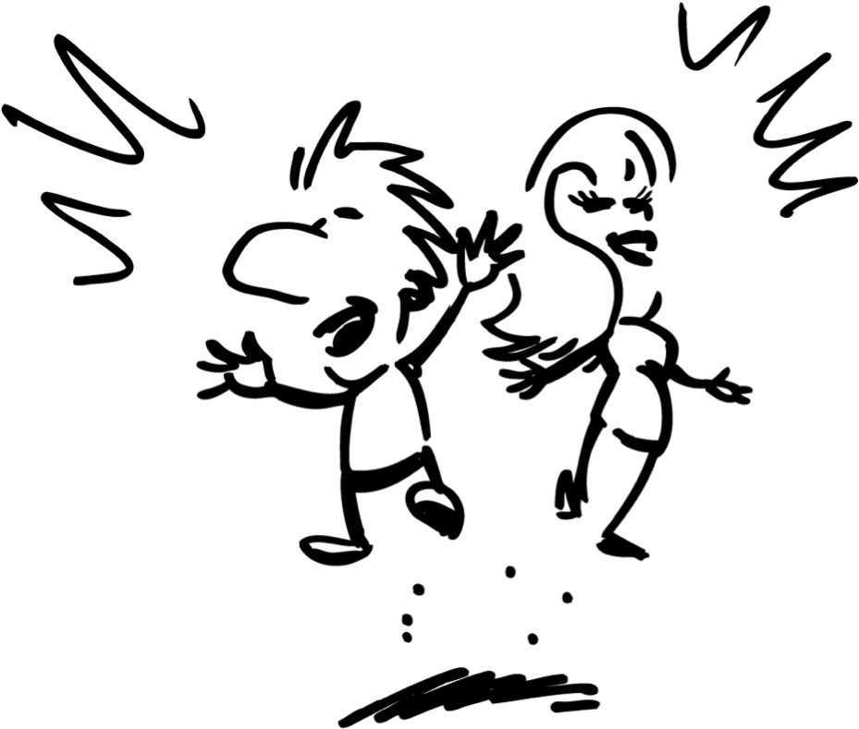
THANK YOU!
MOIMR Film 1: Moving On (a 20-minute film)
https://vimeo.com/175253959
MOIMR Film 2: Keep On Moving On (2 ½ years later)
https://vimeo.com/265578904
A Feasibility Study of MOIMR
https://alcoholchange.org.uk/publication/a-feasibility-study-of-moving-on-in-my-recovery
Email: brajna@moimr.com
Website: www.moimr.com

